Slide 1

IPL DATA ANYALYSIS
2008-2016
PRESENTED BY: RAJBHUWAN JAITAWAT AND GROUP

Slide 2
Why this Projects ?
Welcome to the IPL Data Analysis presentation. In this analysis, we explore the dynamic world of the Indian Premier League (IPL) through a comprehensive examination of the provided dataset. The dataset encompasses a wide array of information, including match outcomes, player details, venues, scores etc.
Purpose of the Analysis:
The primary purpose of this analysis is to find valuable insights, patterns, and trends within the IPL dataset. By leveraging data-driven methodologies using SQL quires, we aim to give as much as output from the given dataset. We learnt how to read the dataset and find the possible outcome from the same. We learnt how to use SQL language to find the perfect output and in final step we learnt how to use power bi for visualize our data using dashboards

Slide 3
STRUCTURE OF THE DATASET
Table Name | Columns
ball_by_ball | Match_Id, Over_Id, Ball_Id, Innings_No, Team_Batting, Team_Bowling, Striker_Batting_Position, Striker, Non_Striker, Bowler
batsman_scored | Match_Id, Over_Id, Ball_Id, Runs_Scored, Innings_No
batting_style | Batting_Id, Batting_hand
bowling_style | Bowling_Id, Bowling_skill
city | City_Id, City_Name, Country_id
country | Country_Id, Country_Name
extra_runs | Match_Id, Over_Id, Ball_Id, Extra_Type_Id, Extra_Runs, Innings_No
extra_type | Extra_Id, Extra_Name
matches | Match_Id, Team_1, Team_2, Match_Date, Season_Id, Venue_Id, Toss_Winner, Toss_Decide, Win_Type, Win_Margin, Outcome_type, Match_Winner, Man_of_the_Match
win_by | Win_Id, Win_Type
wicket_taken | Match_Id, Over_Id, Ball_Id, Player_Out, Kind_Out, Fielders, Innings_No
venue | Venue_Id, Venue_Name, City_Id
toss_decision | Toss_Id, Toss_Name
team | Team_Id, Team_Name
season | Season_Id, Man_of_the_Series, Orange_Cap, Purple_Cap, Season_Year
rolee | Role_Id, Role_Desc
player_match | Match_Id, Player_Id, Role_Id, Team_Id
player | Player_Id, Player_Name, DOB, Batting_hand, Bowling_skill, Country_Name
outcome | Outcome_Id, Outcome_Type
out_type | Out_Id, Out_Name

Slide 4
Key Metrics Explored:
Match Outcomes:
Identification of winning teams.
Analysis of win types and margins.
Season Performances:
Man of the series each season.
Match summary.
Total Catches in Each Season.
Team Dynamics:
Winning counts of each team.
Player and their roles.
Individual Achievements:
Orange Cap and Purple Cap winners.
Different out types and their counts

Slide 5
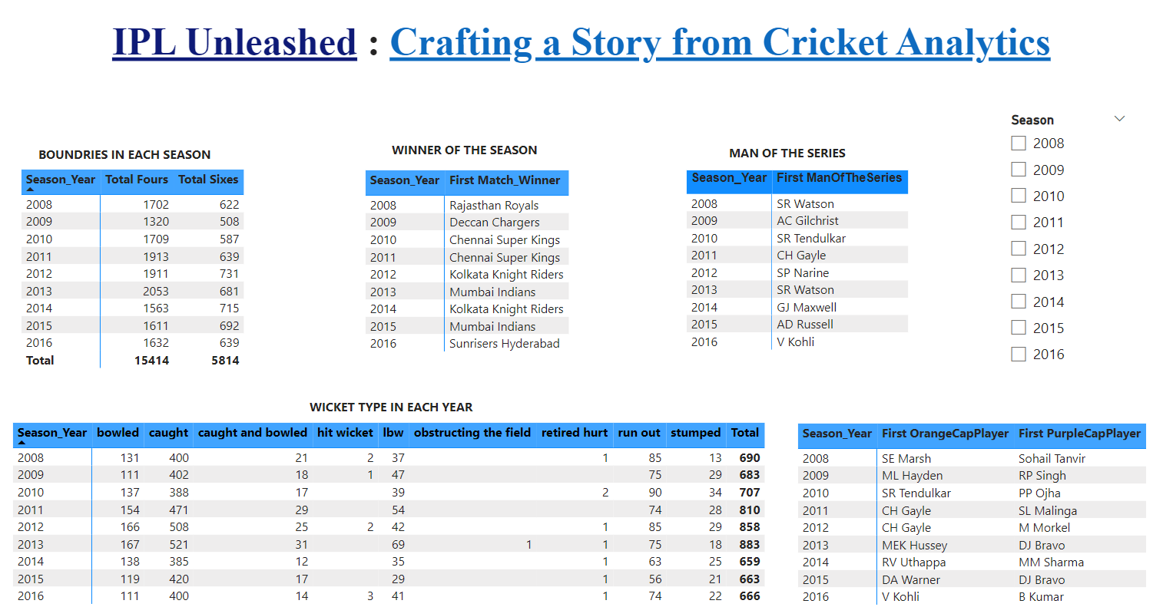
Power Bi Dashboard 1

Slide 6
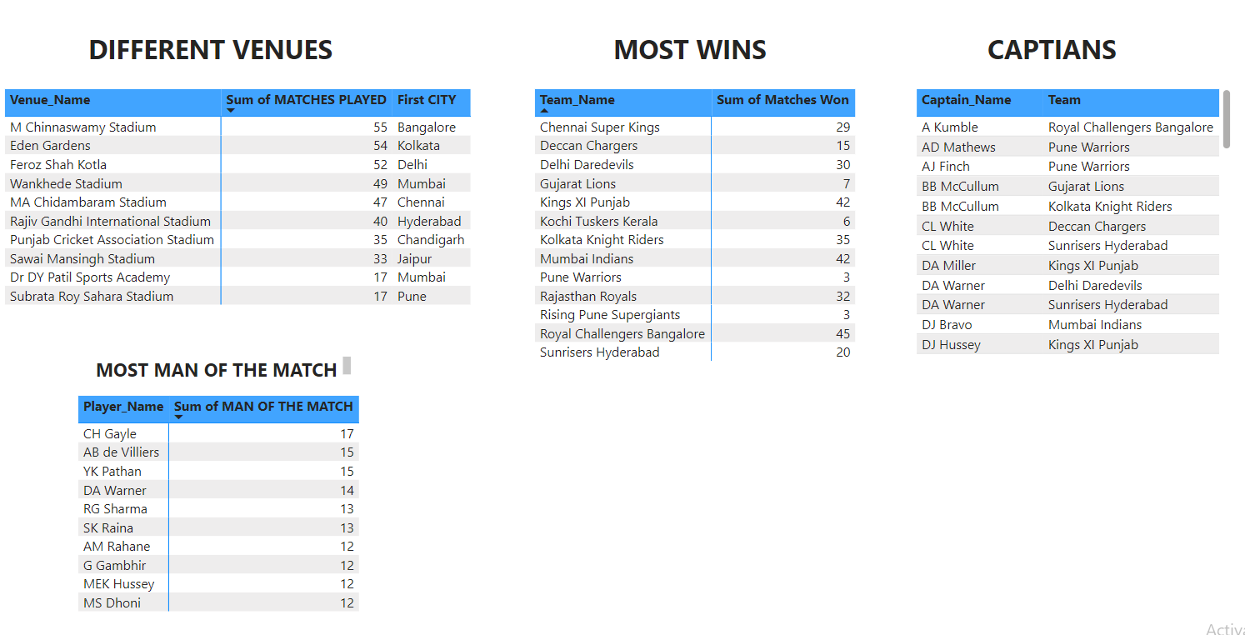
Power Bi Dashboard 2

Slide 7
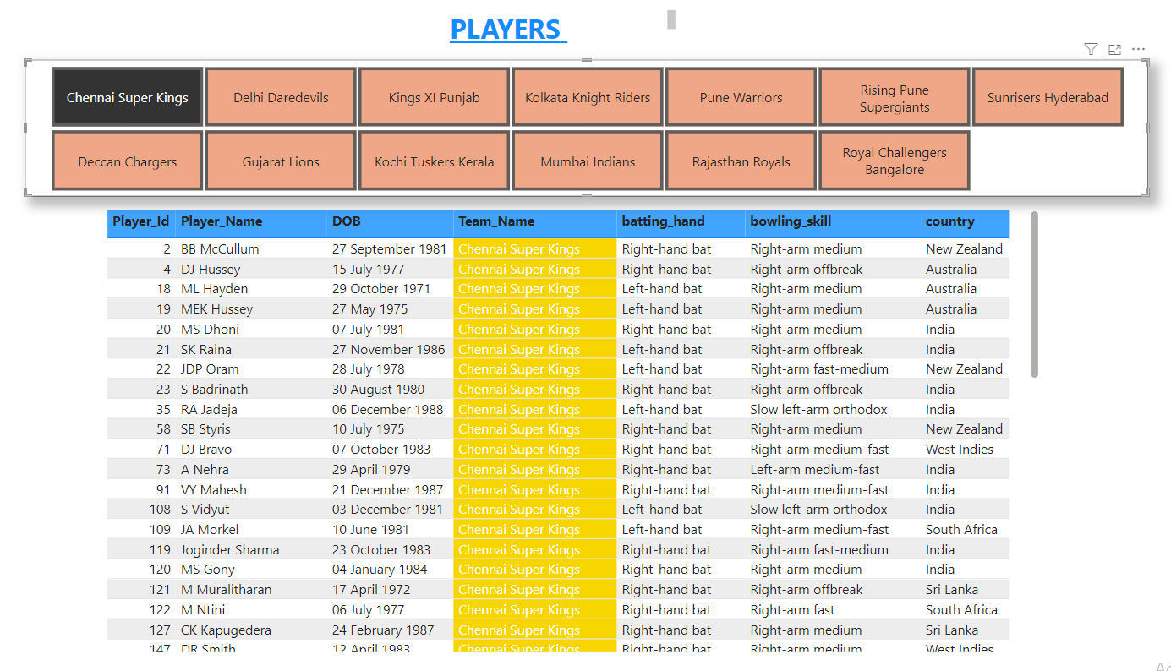
Power Bi Dashboard 3

Slide 8
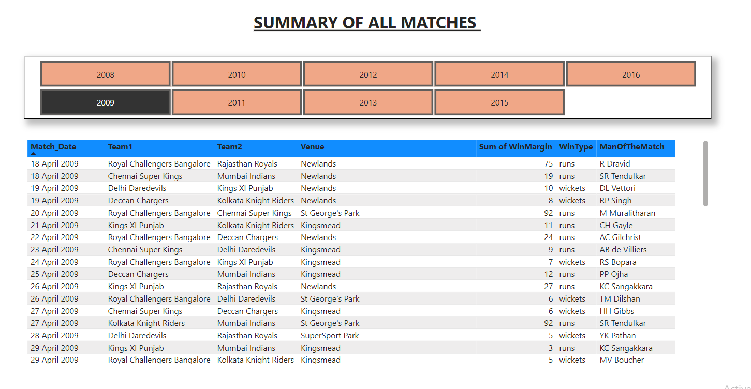
Power Bi Dashboard 4

Slide 9
Conclusions:
Team Performance:
Recognized winning teams and analyzed victory margins.
Unveiled strategies employed by teams for match outcomes.
Player Excellence:
Identified top run-scorers in each season.
Explored the best batting figures and highest wicket-takers.
Team Leadership:
Uncovered captains and their roles in guiding teams.
Individual Recognition:
Acknowledged Orange Cap and Purple Cap winners.

Slide 10
Thank you!!!

